Slide 1
Heather Symes RN
Te Whare Rangahau
Forensic community team Christchurch
Women's Health College conference 2022

Slide 2
"Our Wahine, their future"
Aim: To provide an overview of Women in Forensic Psychiatry who are resident in NZ prisons.
•Female mental disorder
•Secure places?
•Mental disorder in Prisons
•Trauma & Family Violence

Slide 3
INCARCERATION of Women has fundamental determinants
Loss of relationships, homes and whanau/pipi/friends
Loss of social and financial influence and stability
Discrimination re roles/ jobs /disability
Loss of self esteem/identity
Shame and isolation from whanau/family
Exposure to mental unwellness/physical abuse/isolation
Lack of empowerment/mana
Trauma and abuse
Nature / Nurture

Slide 4
Women's prison’s in NZ
NUMBER OF PRISONERS IN EACH LOCATION BY CUSTODY STATUS AS AT 31 MARCH 2021
There are three women's prisons in New Zealand. Auckland Region Women's Corrections Facility (ARWCF) in Wiri, Manukau City has 286 beds. Arohata Women's Prison in Tawa, north of Wellington has 88 beds. Christchurch Women's Prison, 20 km south of Christchurch has 140 beds.
Prison\Corrections Facility | Remand Prisoners | Population %
Total Female Prisoners | 252 | 6.3%
Arohata Prison | 49 | 1.2%
Auckland Region Women's Corrections Facility | 175 | 4.1%
Christchurch Women's Prison | 28 | 1.0%

Slide 5
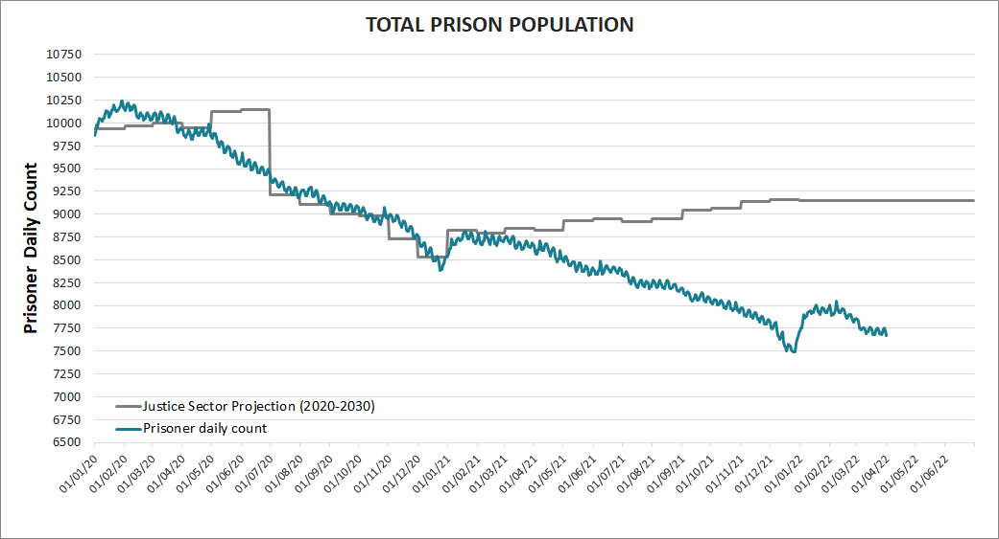
Male and female prison population March 2022 trend

Slide 6
March 2022 women in NZ Prisons
Total Female Prisoners | 209 | 210 | 419 | 7 | 426 | 5.6%
Arohata Prison | 47 | 43 | 90 | 1 | 91 | 1.2%
Auckland Region Women's Corrections Facility | 122 | 124 | 246 | 5 | 251 | 3.3%
Christchurch Women's Prison | 40 | 43 | 83 | 1 | 84 | 1.1%

Slide 7
New Beginnings - Mothers with Babies Unit
What is the Mothers with Babies Unit?
The Mothers with Babies Unit gives you a unique opportunity to be with your child, and get the help you need to make positive changes and stay offence free when you are released.
You get to care full time for your child in a safe and supportive environment with wrap-around services to support you in your parenting.
Placement will be in the best interests of the child.
What’s best for baby
Your child deserves the best possible start in life.
The Mothers with Babies Unit offers you and your baby:
a stable, safe environment
a chance to grow your relationship
support from experienced, caring staff
support from skilled outside providers
access to rehabilitation and reintegration programmes.
Other solutions
If having your baby with you in prison is not the best choice for you both, there are ways we can help you to stay in touch and grow your mother/baby relationship.
You can use special bonding facilities on site where you and your child can regularly spend time together for bonding purposes.
Where are the Mothers with Babies Units?
Our three Mothers with Babies Units are in Auckland Region Women’s Corrections Facility, Arohata Prison (Wellington) and Christchurch Women’s Prison.

Slide 8
If you join the programme, we will try to place you near family, whanau and other significant people in your baby’s life. The aim is to help you grow positive relationships with others who can support you in your parenting once you are released.

Slide 9
Criteria for Mums
You may be eligible to apply for Mothers with Babies if:
you are pregnant and will give birth before your release from custody
you have a child who is younger than 24 months, and
  you were their main caregiver before you were imprisoned OR
  you are likely to be their primary caregiver on release
you have no convictions for sexual or violent offences involving children.
You must be:
drug free and have no serious misconducts
motivated to live in the unit and care for your child
willing to be assessed to ensure that the decision to care for your child in prison is a safe and appropriate option.

Slide 10
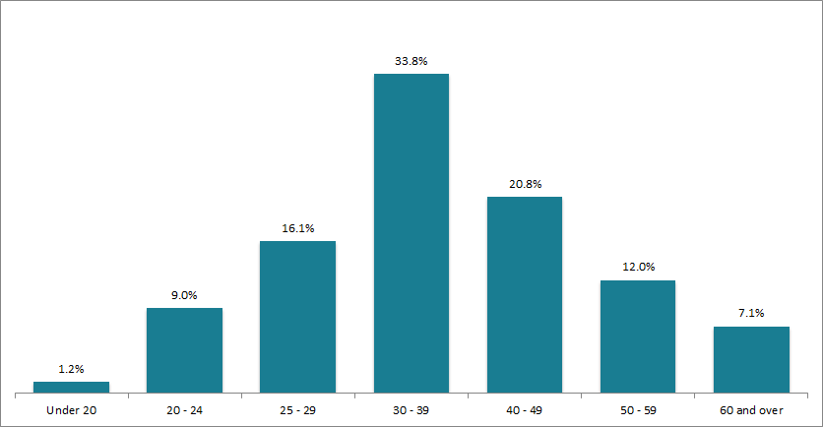
Age groups of prisoners in NZ Prisons

Slide 11
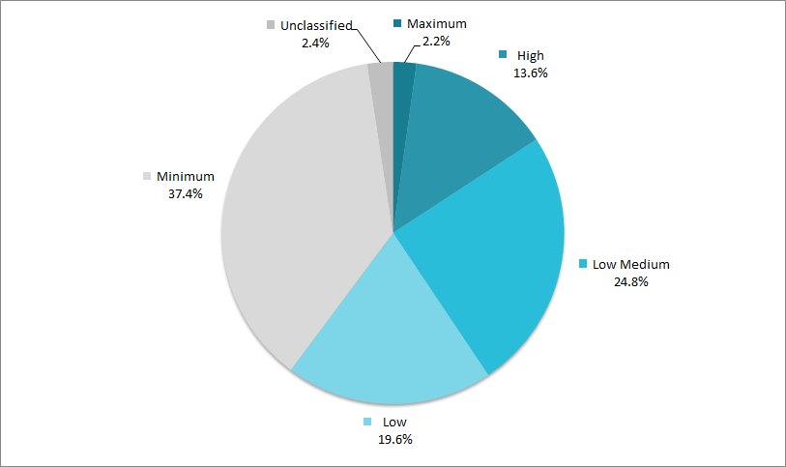
Security Classification of prisoners

Slide 12
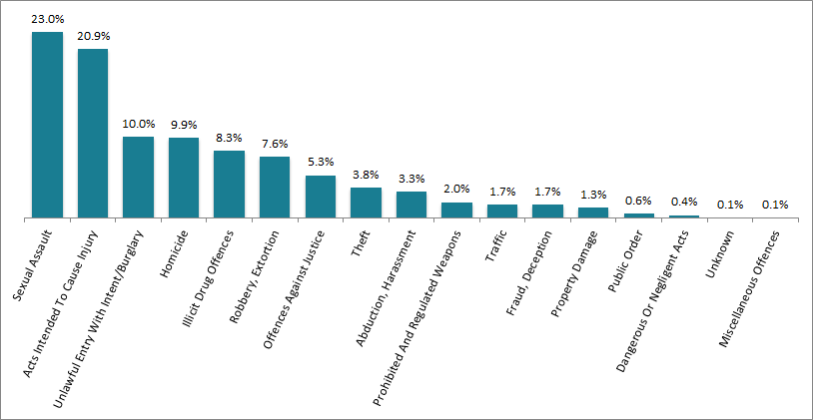
Offence type prisoners may be convicted of offences across multiple categories'.

Slide 13
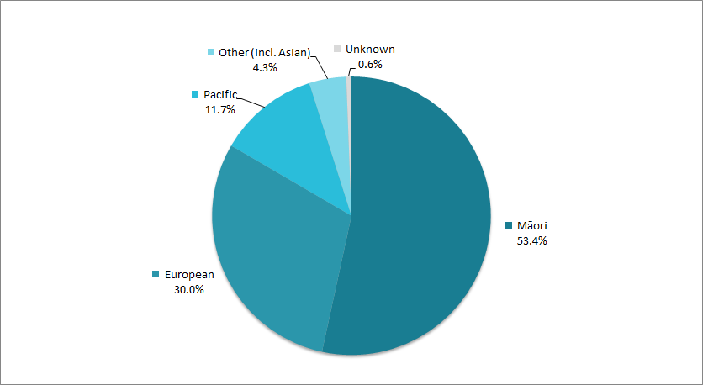
Ethnicity of NZ Prisoners

Slide 14
Some Key Statistics
62% of women in prison have had both (comorbid) mental health and substance disorders across their lifetimes.
52% of women in prison have suffered post traumatic stress disorder across their lifetime.
44% of women in prison have experienced drug dependence disorders across their lifetime
68% of women in prison have been the victim of family violence
66% of women in prison are Maori
46% of women in prison have a lifetime alcohol dependence
75% of women in prison have had a diagnosed mental health condition in last 12 months
46% of women in prison are on remand

Slide 15
Key statistics continued
66% of women in prison are Maori.
Women on Community Sentences
19% of total number of people on Community sentences are women
54% of those are Maori.
NZ is a world leader in imprisoning our indigenous population.
NZ Population 17% are Maori!

Slide 16
Common mental health disorders of women in CHC Women's prison
Anxiety, PTSD, OCD, Sexual abuse histories.
Depression, Dysthymic disorder
Bipolar disorder, Schizophrenia disorder ,psychotic episodes
Methamphetamine, Synthetic dependence
THC, Nicotine & Alcohol abuse
Past physical and psychological abuse, trauma

Slide 17
Realities of being in prison in NZ 2021
One woman struggled to change her sanitary pad with handcuffs on. Another was made to shower with chains on and the door ajar. Several were forced to give birth with Corrections officers present and chatting among themselves in the room, including one woman who had four officers present.
Another was placed in the back “cage” of a transport van while heavily pregnant, despite protesting about the danger to her and her baby.
The Children’s Commission gave these practices a red “detrimental” classification, the worst possible, saying they actively caused harm and were negligent. It recommended the urgent review and clarification of policies relating to pregnant, labouring and postnatal prisoners.

Slide 18
Yet multiple incidents are detailed in a 2019 report undertaken by the Office of the Children’s Commissioner into the Mothers with Babies Unit (MBU) at Auckland Region Women’s Corrections Facility, obtained by Stuff under the Official Information Act.
The visit is facilitated by the Ombudsman’s office as part of its role to uphold the United Nations Optional Protocol to the Convention against Torture and Other Cruel, Inhuman or Degrading Treatment or Punishment (OPCAT.)

Slide 19
Michelle Duff May 09 2021 NZ Stuff article
Women are being forced to give birth in handcuffs, with prison officers in the room
Women are being forced to give birth in handcuffs, struggling to feed their new babies while they are shackled, and being made to labour with Corrections officers in the room. Michelle Duff investigates the reality for incarcerated pregnant women.
The woman only had her handcuffs removed for a moment. In the final stages of labour, when the contractions were at their peak, she was allowed to have them taken off.
Straight after she had given birth, the prison officer shackled the woman again. She had her first shower with cold steel around her wrists. When a doctor asked that they be removed, the officer turned to them. “I don’t tell you how to do your job, so don’t tell me how to do mine.”
Her midwife sought special permission for the woman to be unchained from the bed so she could have skin-to-skin contact with her new-born.

Slide 20
Misunderstanding by staff led to Mothers and Babies unit at Prison being unoccupied for 8yrs
Stuff article 12/05/2022 reported “Wellington Women's Prison M & B Unit empty for 8yrs due to safety concerns” with building and position of building.
Office of Children's Commissioner (OCC) report in 2020 released this month.
Mums locked up for 21/24hrs day.
Denied extra food when pregnant and hungry
No opportunity to be with children unless they moved to CHCH or Auckland women's prison, often away from whanau/family/support.
Continued punishment and abuse of pregnant Women in prison
Is this what we really want to happen in NZ?

Slide 21
Information sources for this slide show
Stuff newspaper articles May 2022
www. Corrections.govt.nz/resources/strategic_reports
Office of Children's Commission Reports -online
Own experiences of working with Women at CHCH Women's Prison
McIntosh T. (2017). Behind the wire: Maori women and prison Womens studies Journal,31(1),114-116
Hokai Rangi overarching organisational strategy 2019
Indig, D., Gear,C., and Wilhelm,K,. Comorbid substance use disorders and mental health disorders among NZ prisoners, NZ Dept Corrections 2016
“Women rising above a new Horizon” Women's Strategy 2021-25 DoC

